Slide 1
Decomposition

Slide 2
Undesirable Properties of Bad Design
Redundancy, resulting in waste of space and complicated updates (inconsistencies.)
Inability to represent certain information – ex Null values.
Loss of information.

Slide 3
How to avoid ?
Properties of information repetition and null values suggest -- Decomposition of relation schema.
Properties of information loss -- Non-lossy-join decomposition.

Slide 4
Decompositions
There are careless, “bad” decompositions.
There are three desirable properties:
1. Lossless.
2. Dependency preservation.
3. Minimal redundancy.

Slide 5
Relation Decomposition
One of the properties of bad design suggests to decompose a relation into smaller relations.
Must achieve lossless-join decomposition.

Slide 6
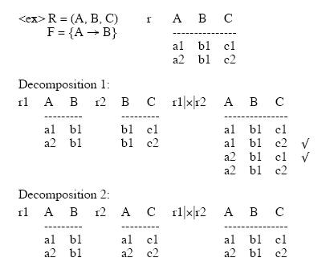
Example of Relation Decomposition

Slide 7
Lossless Join Decomposition
Definition:
  Let { R1, R2 } be a decomposition of R (R1 U R2 = R); the decomposition is lossless if for every legal instance r of R:
  r = ΠR1(r) |X| ΠR2(r)

Slide 8
Testing Lossless Join
Lossless join property is necessary if the decomposed relation is to be recovered from its decomposition.
Let R be a schema and F be a set of FD’s on R, and α = (R1, R2) be a decomposition of R. Then α has a lossless join with respect to F iff
R1 ∩ R2 -> R1 (or R1 - R2 ) or
R2 ∩ R1 -> R2 (or R2 - R1 )
where such FD exist in Closure of F
PS This is a sufficient condition, but not a necessary
condition.

Slide 9
Example of L-J Decomposition
From the previous example : R = (ABC) F = {A -> B}
R1 = (AB), R2 = (AC)
R1∩ R2 = A, R1- R2 = B
check A -> B in F ? Yes. Therefore lossless
R1 = (AB), R2 = (BC)
R1∩ R2 = B, R1 - R2 = A , R2 - R1= C
check B -> A in F ? NO
check B -> C in F ? NO
So, this is lossy join.

Slide 10
Another example
R = (City, Street, Zip) F = {CS -> Z, Z -> C}
R1 = (CZ) R2 = (SZ)
R1 ∩ R2 = Z , R1 – R2 = (C)
check Z -> C in F ? Yes
Therefore, the decomposition to be (CZ) (SZ) is
lossless join decomposition.

Slide 11
Why do we preserve the dependency?
We would like to check easily that updates to the database do not result in illegal relations being created.
It would be nice if our design allowed us to check updates without having to compute natural joins.

Slide 12
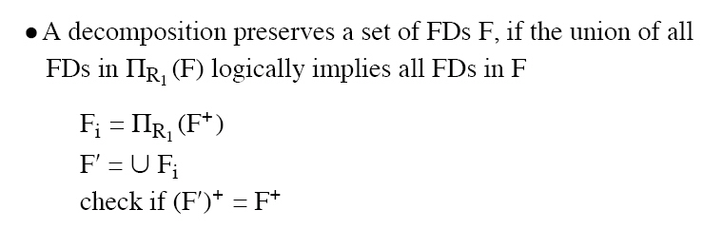
Dependency Preservation Decomposition
Definition: Each FD specified in F either appears directly in one of the relations in the decomposition, or be inferred from FDs that appear in some relation.

Slide 13
Test of Dependency Preservation
If a decomposition is not dependency-preserving, some dependency is lost in the decomposition.
One way to verify that a dependency is not lost is to take joins of two or more relations in the decomposition to get a relation that contains all of the attributes in the dependency under consideration and then check that the dependency holds on the result of the joins.

Slide 14
Test of Dependency Preservation II
Find F - F', the functional dependencies not checkable in one relation.
See whether this set is obtainable from F' by using Armstrong's Axioms.
This should take a great deal less work, as we have (usually) just a few functional dependencies to work on.

Slide 15
Dependency Preserving Example
Consider relation ABCD, with FD’s :
A ->B, B ->C, C ->D
Decompose into two relations: ABC and CD.
ABC supports the FD’s A->B, B->C.
CD supports the FD C->D.
All the original dependencies are preserved.

Slide 16
Non-Dependency Preserving Example
Consider relation ABCD, with FD’s:
A ->B, B ->C, C->D
Decompose into two relations: ACD and BC.
ACD supports the FD B ->C and implied FD A ->C.
BC supports the FD B->C.
However, no relation supports A ->B.
So the dependency is not preserved.

Slide 17
Minimal Redundancy
In order to achieve the lack of redundancy, we do some decomposition which is represented by several normal forms.

Slide 18
Normal Form Decompositions
Comparison
3NF Decomposition:
  lossless.
  Dependency preserving.
BCNF Decomposition:
  Lossless.
  Not necessarily dependency-preserving.
  Component relations are all BCNF, and thus 3NF.
4NF Decomposition:
  Lossless.
  Not necessarily are all 4NF, and thus BCNF and 3NF.
No decomposition is guaranteed to preserve all multi-value dependencies.

Slide 19
Lossless Check Example
Consider five attributes: ABCDE
Three relations: ABC, AD, BDE
FD’s: A ->BD, B ->E
 | A | B | C | D | E
ABC | a1 | a2 | a3 | b14 | b15
AD | a1 | b22 | b23 | a4 | b25
BDE | b21 | a2 | b33 | a4 | a5

Slide 20
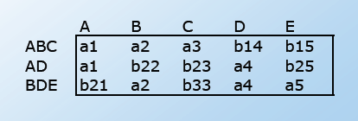
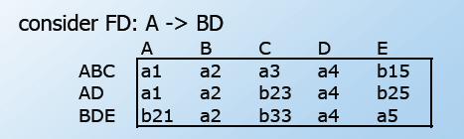
Lossless Check Example

Slide 21
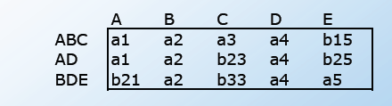
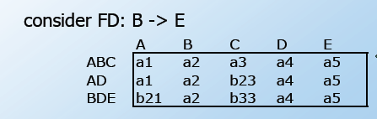
Lossless Check Example

Slide 22
Conclusion
Decompositions should always be lossless.
Decompositions should be dependency preserving whenever possible.
We have to perform the normal decomposition to make sure we get rid of the minimal redundant information.

Slide 23
Reference
http://www.cs.hmc.edu/courses/2004/spring/cs133/decomp.6.pdf
http://www.cs.sfu.ca/CC/354/zaiane/material/notes/Chapter7/node8.html
http://clem.mscd.edu/~tuckerp/CSI3310/C15.1.html
http://wwwis.win.tue.nl/~aaerts/2M400/pdf/ColNotes7.pdf

